Slide 1
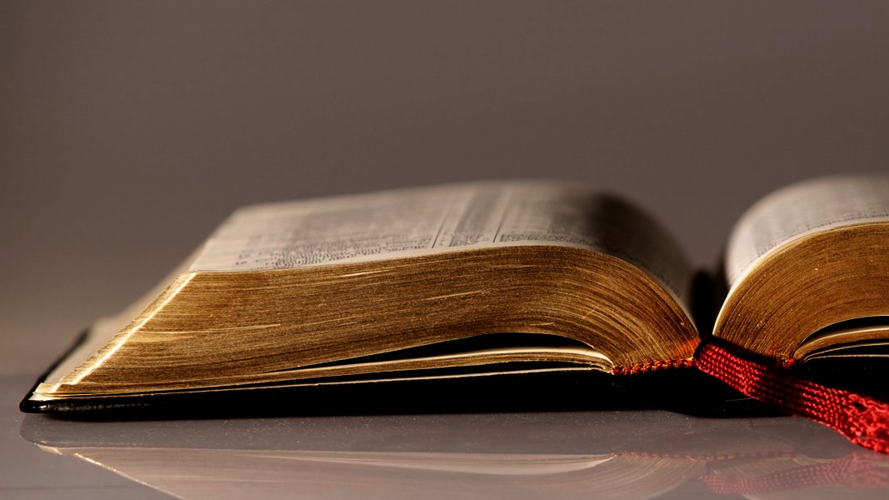
Welcome to
Our Sunday School
We’ll start at 9:07
visit OurSundaySchool.com for more about our class

Slide 2
Today’s class (pages 135-143)
Philippians 2:12-13

Slide 3
Philippians 2:12-13 (CSB)
Therefore, my dear friends, just as you have always obeyed, so now, not only in my presence but even more in my absence, work out your own salvation with fear and trembling. For it is God who is working in you both to will and to work according to his good purpose.

Slide 4
Humiliation and exaltation
2:5-8 humiliation emptied servant humanity humbled death cross
2:9-11 exaltation highly exalted name above knees bow tongues confess Jesus Christ is Lord

Slide 5
Today’s class (pages 135-143)
Philippians 2:12-13

Slide 6
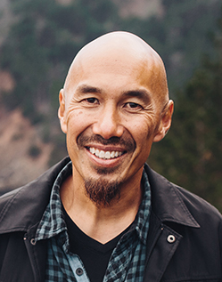
Dr. Tony Merida & Frances Chan As Paul teaches us about sanctification, he commends… then he commands… then he comforts…

Slide 7
Today’s class (pages 135-143)
Philippians 2:12-13

Slide 8
Prayer Time
Write down your prayer requests (on the Weekly Update or in the comments)
Lean in, engage, and pray for someone not with you
Go worship

Slide 9
Today’s class (page 16)
Preparing for Philippians 1:1-30
Pray with others
Hear with others
Think with others
Study with others In class, as a table
Share with others
Invite others After class
In class, as a class

Slide 10
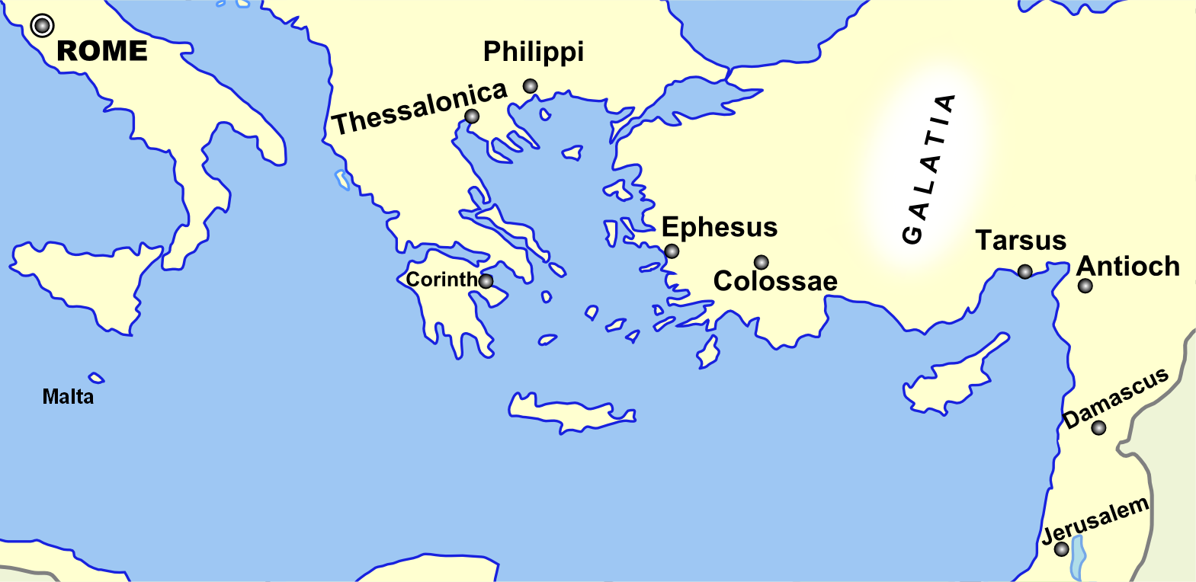
Monozigote. (2012). Broad Overview of Geography Relevant to Paul of Tarsus [Map]. Wikipedia.

Slide 11
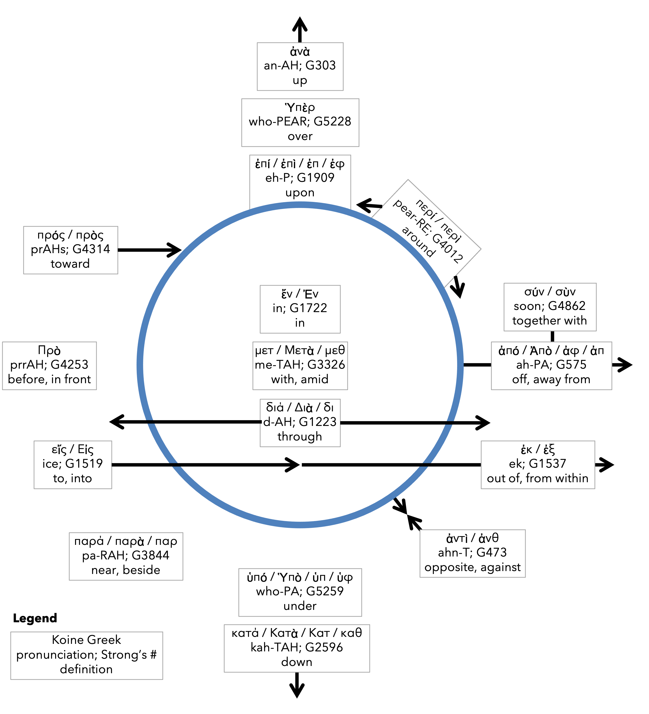
Preposition circle (page 11)

Slide 12
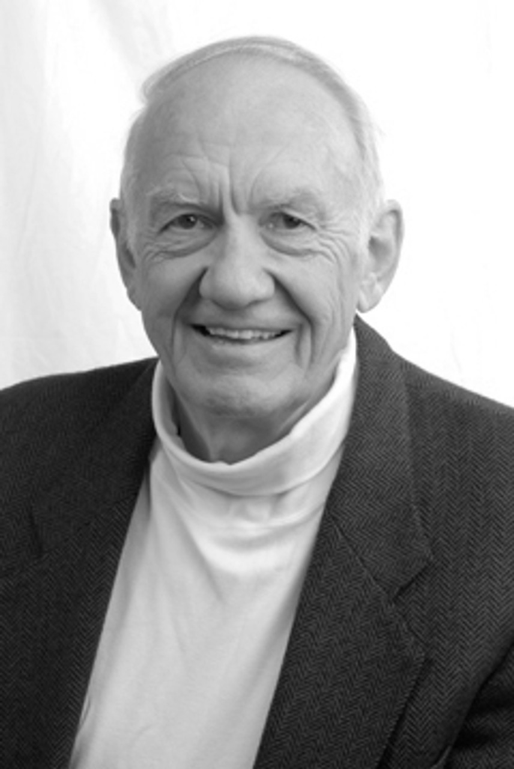
Dr. Gordon Fee Quote

Slide 13
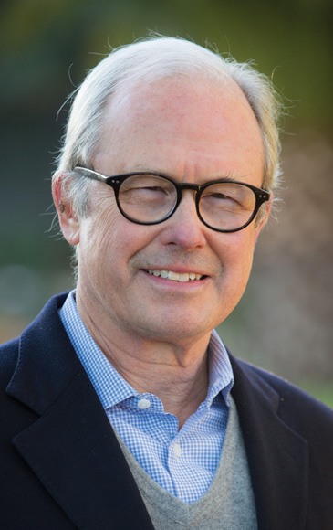
Dr. G. Walter Hansen Quote

Slide 14
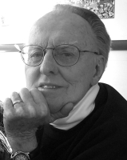
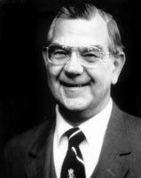
Dr. G. F. Hawthorne & Dr. Ralph P. Martin Quote

Slide 15
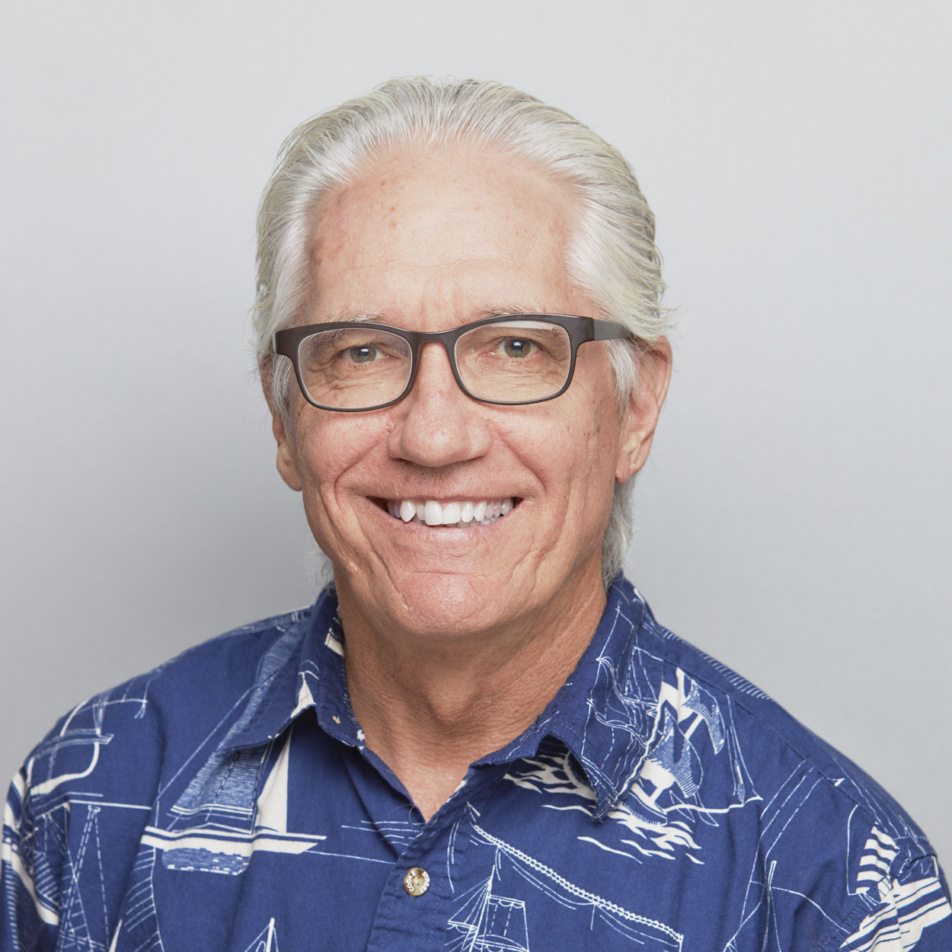
Dr. Joe Hellerman Quote

Slide 16
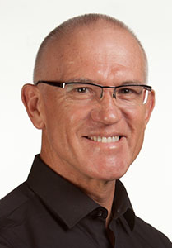
Dr. Mark Keown Quote

Slide 17
Dr. Ralph P. Martin Quote

Slide 18
Dr. Tony Merida & Frances Chan Quote

Slide 19
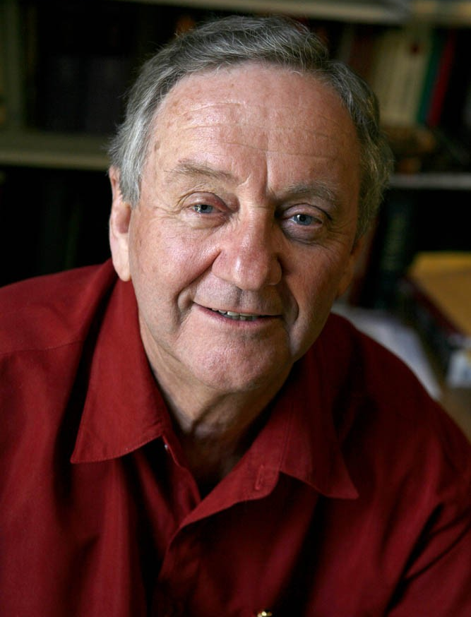
Dr. Peter T. O’Brien Quote

Slide 20
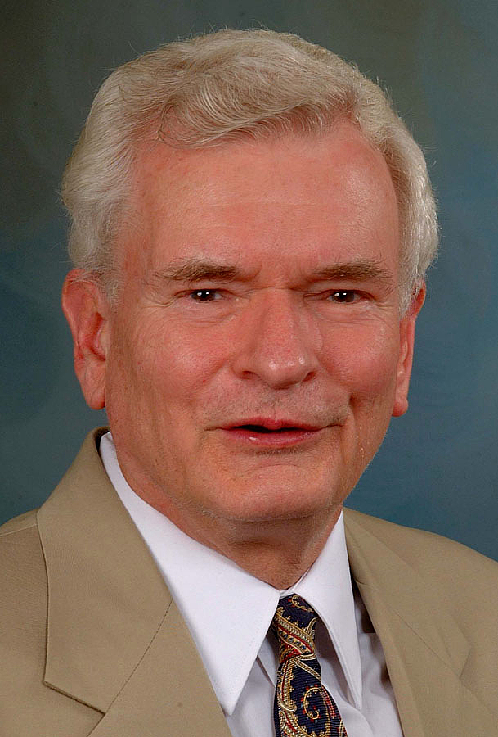
Dr. John Reumann Quote

Slide 21
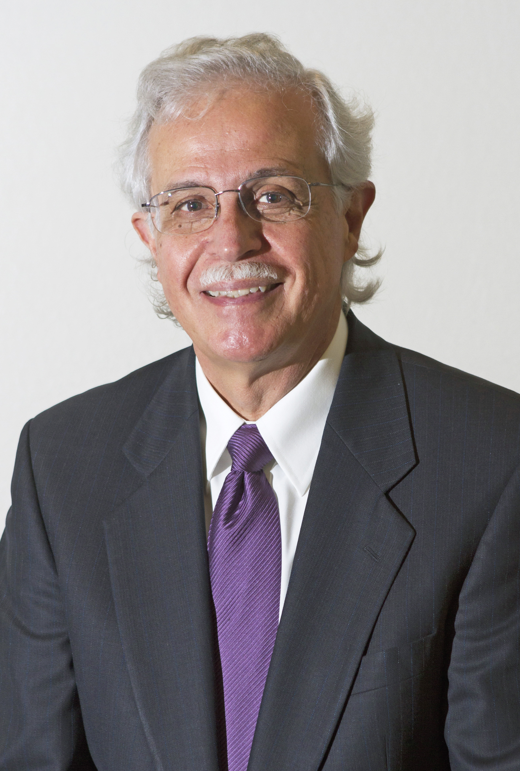
Dr. Moises Silva Quote

Slide 22
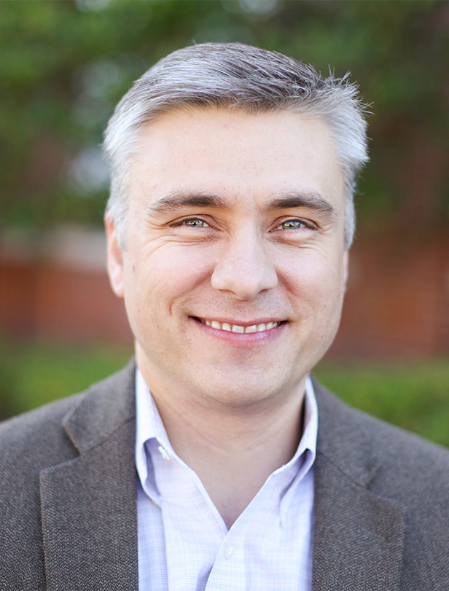
Dr. David T. A. Strain Quote

Slide 23
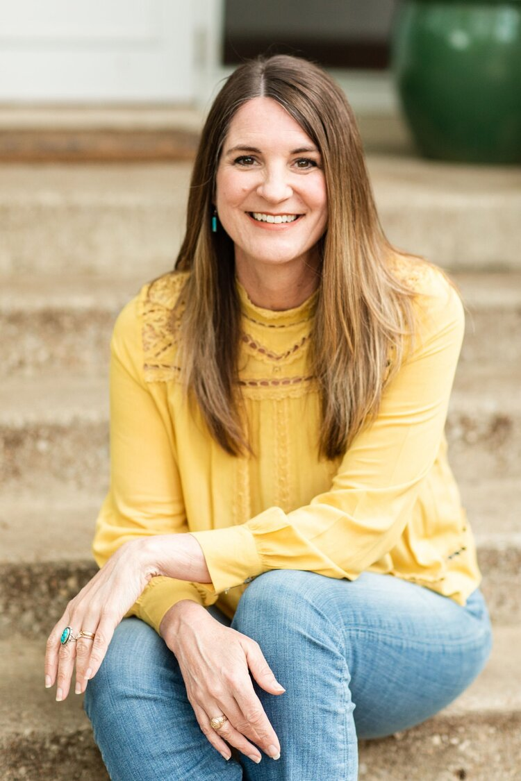
Jen Wilkin Quote

